Slide 1
Lab 1 – FRE 501
R fundamentals and applications

Slide 2
Why do you have labs?
Assist with your assignments
Strengthen coding skills
Solve your programming queries and troubleshooting (also done in office hours)
Timings:
Tuesday and Thursday 9:30 am - 10:30 am
Tuesday 4:30 pm – 6:00 pm

Slide 3
Contact
Slack - for quick replies
Email (during working hours) : riya2023@mail.ubc.ca
Ask common queries on your slack group (FRE501) – Does everyone have access?

Slide 4
A few house rules ☺
Questions and engagement is encouraged. Raise your hand to ask me a question and I will also prompt you to ask questions in between.
You are encouraged to work together to solve problems

Slide 5
R familiarity – Class activity
Little to no experience
Moderate (personal projects)
Professional use
Daily use

Slide 6
Today’s contents
Organizing your projects and assignments
GIT fundamentals and setup (Office hour)
R fundamentals
Package installing and loading
Reading data, cleaning and preprocessing using DPLYR
Plotting and exporting graphs using GGPLOT
Linear modelling using lm()
Printing results in a readable format using STARGAZER

Slide 7
Formal objectives
Understand the concept of open interest
Learn the functionalities and nuances of various R packages
Understand the difference between various operators and data types
Understand how to handle "date and time" data
Learn how to plot using ggplot package

Slide 8
Learning outcome
Able to load and use necessary packages
Able to identify which operator is necessary and use them to solve problems
Able to handle various data types and convert to necessary formats
Able to plot figures as necessary
Able to define and analyze open interest

Slide 9
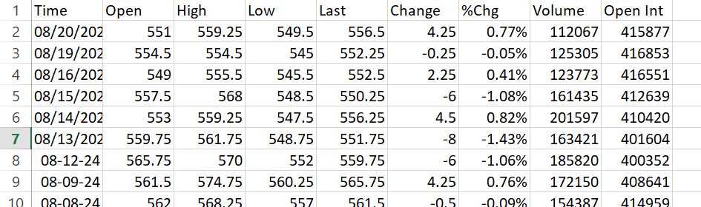
The big picture
Objective : Analysis of Open Interest for the commodity “Wheat” by using its historical data
Notes:
Top down approach
Building solutions to problems in agricultural econ
Today we analyse the wheat historical dataset

Slide 10
Data – Wheat Historical
Time: The date of the trading session.
Open: The opening price of wheat futures on that particular day.
High: The highest price reached during the trading session.
Low: The lowest price reached during the trading session.
Last: The last traded price of the futures contract for that day.
Change: The difference in the last price compared to the previous trading day's last price.
%Chg (% Change): The percentage change in the last price compared to the previous trading day's last price.
Volume: The total number of contracts traded during the session.
Open Int (Open Interest): The total number of outstanding contracts that are open or not settled at the end of the trading day.

Slide 11
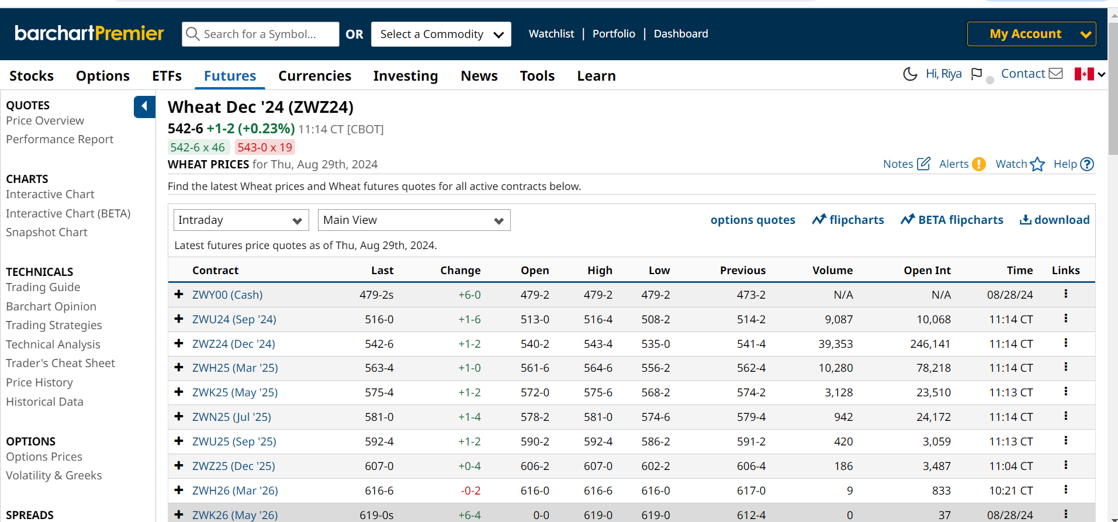
Barchart.com
Notes:
Platform for dataset

Slide 12

Let’s start at the very beginning!
Organization of your files – Very Important!
Create a folder on desktop called “FRE 501”
Create necessary folders (labs, assignments)
Image credit: https://www.dreamstime.com/unorganized-office-papers-businessman-overwhelmed-work-messy-paper-documents-pile-files-stack-unfinished-office-document-work-image138923251
Notes:
Create folder – add image of ideal folder and talk about how to continue in future
Use cartoon

Slide 13
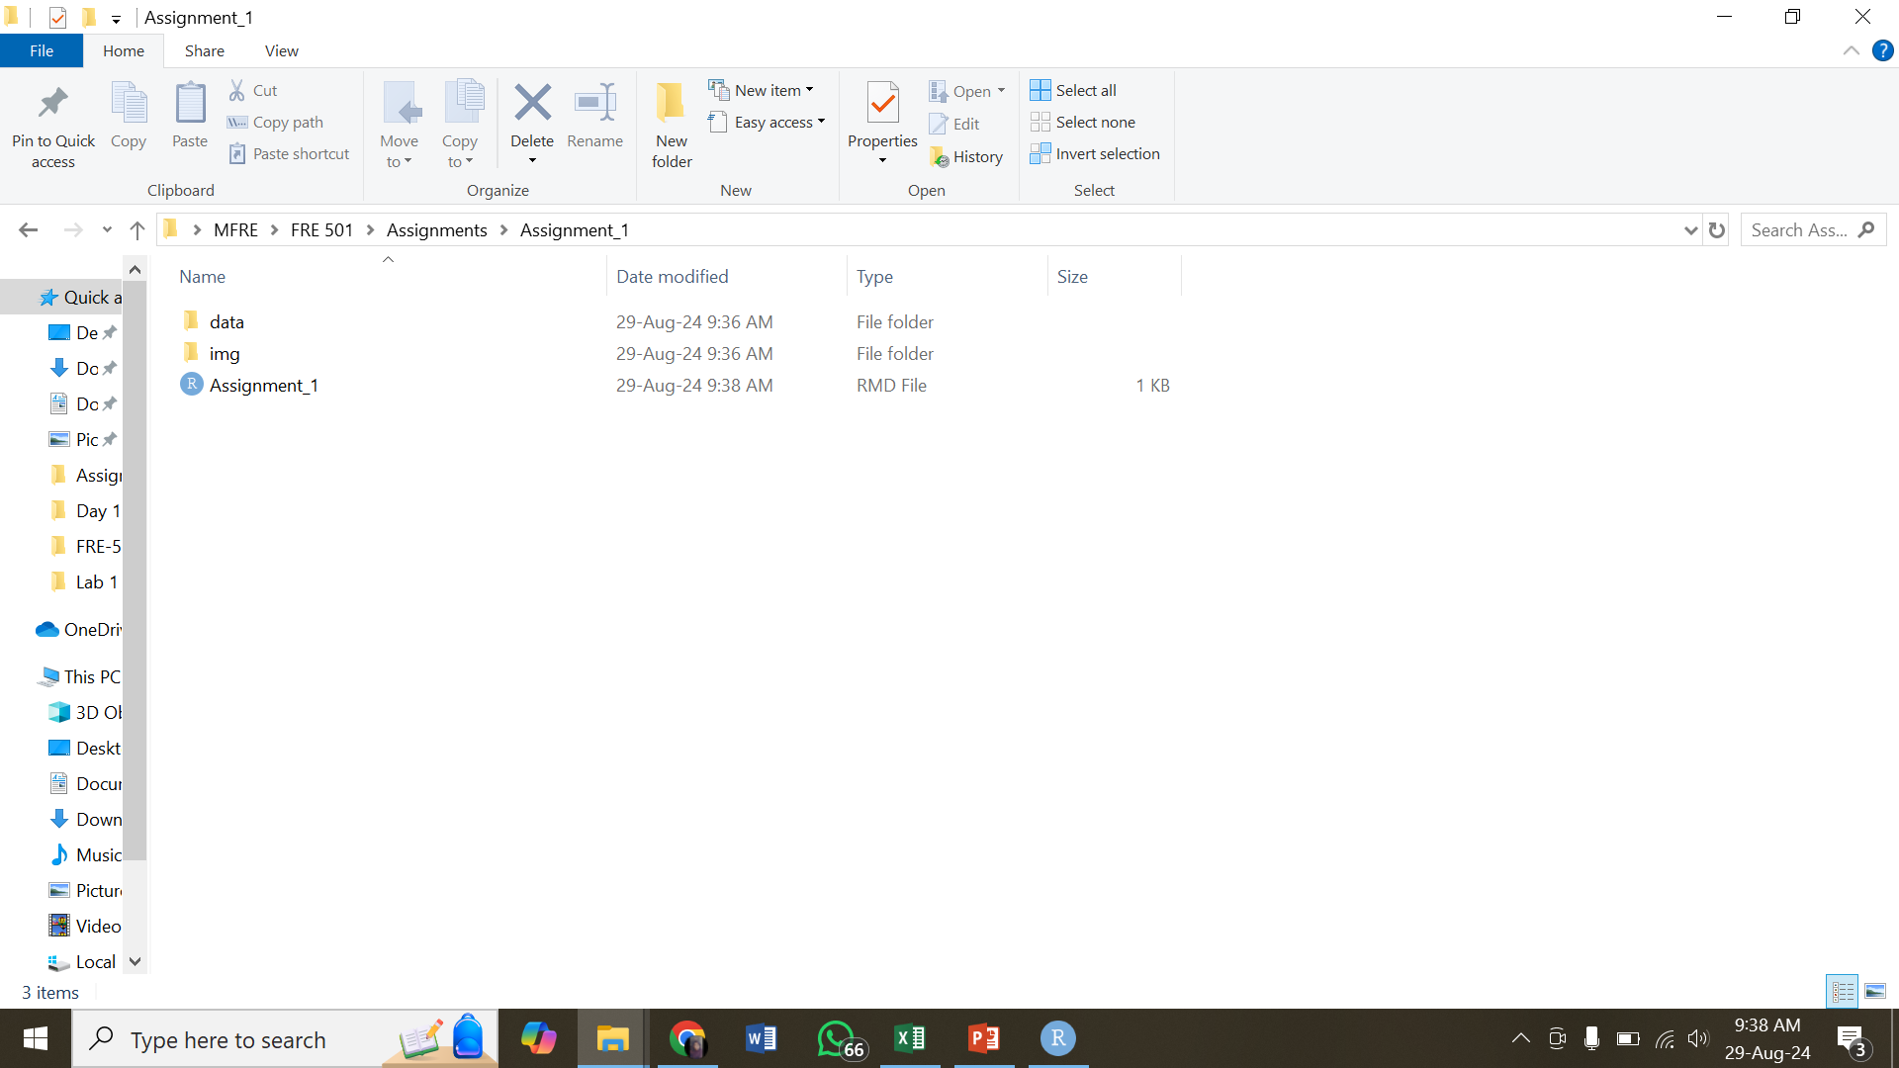
File organization
Notes:
Image of ideal project folder

Slide 14
Assignment submission
3 main deliverables:
Completing the canvas MCQs and plot submissions
Rmd file
HTML file (Knit from Rmd)

Slide 15

Questions?
Credits: https://www.istockphoto.com/photos/cartoon-question-marks

Slide 16
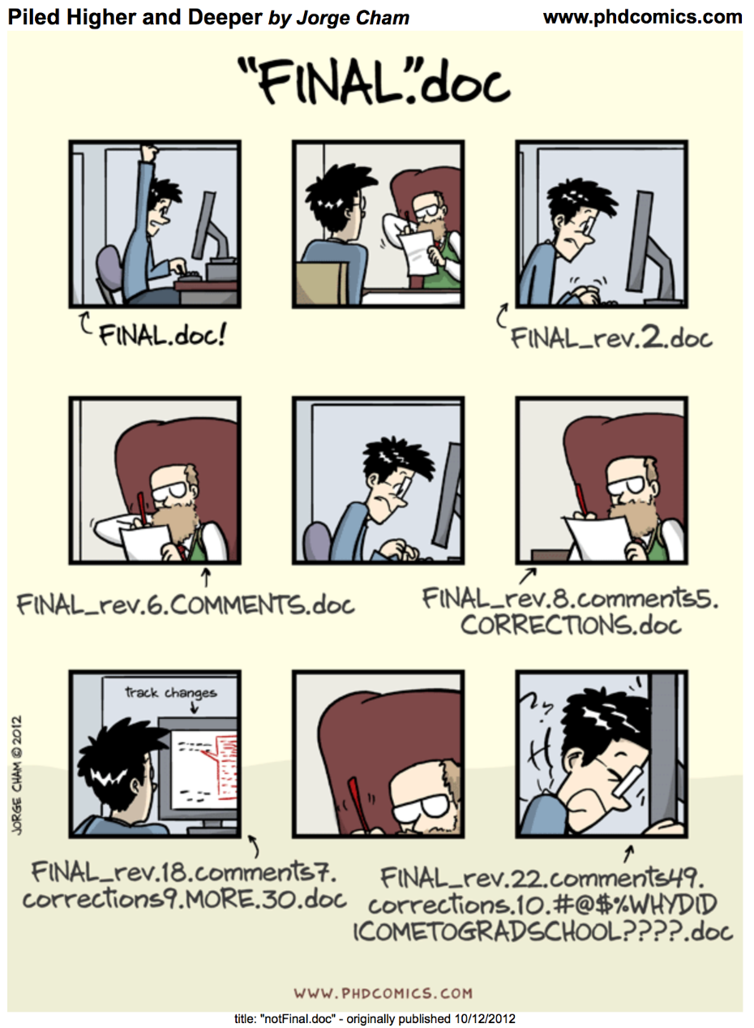
GITHUB
GIT (Global Information Tracker) is a version control system, keeps track of your progress. It is like saving your work at each step, but with a timestamp.
You can even retrieve your old work if you have made a mistake!
Image credit: https://phdcomics.com/comics/archive.php?comicid=1531
Notes:
What is git? Why use?
Keep track of work, show progress, version control, can retrieve old content
Use a cartoon (version control)
Private repo

Slide 17
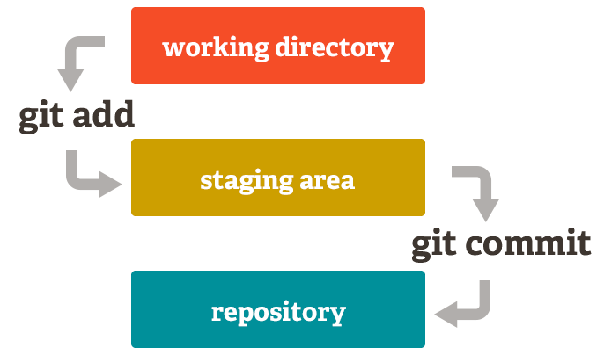
Commands
git add file_name
git commit –m “Question 2 done”
git push origin main
Using GIT is not mandatory for FRE 501, but it is a good practice!

Slide 18
Activity - Create your assignment repository
Create a private repo on GitHub
Clone to your desktop
Work on it from your local
Push to GitHub

Slide 19
Clone the lab repository
https://github.com/riyaeliza123/FRE-501-Labs

Slide 20
Questions?
Credits: https://www.istockphoto.com/photos/cartoon-question-marks

Slide 21


Slide 22
Using R as a tool
Reproducibility
Availability of in-built functions
Knowledge transfer
Industry prevalence
Notes:
Reproducibility
Show an excel sheet, make changes and show how it cant be reversed

Slide 23
Activity – Let’s revise R fundamentals
Download Lab 1
Lab1.zip from Canvas or
Clone from GitHub or
Download .zip from GitHub
Create a new file “3_sept_lab.Rmd”

Slide 24
Paths in programming
Absolute path:
C:\Users\hp\Desktop\FRE 501\Labs\FRE-501-Labs\Lab 1\data\wheat_historical.csv
Relative path: data\wheat_historical.csv

Slide 25

Canvas activity – exit quiz
Image Credits: https://www.artofliving.org/in-en/quiz-time

